Slide 1
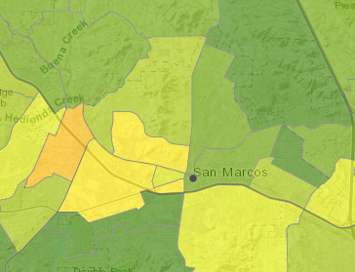
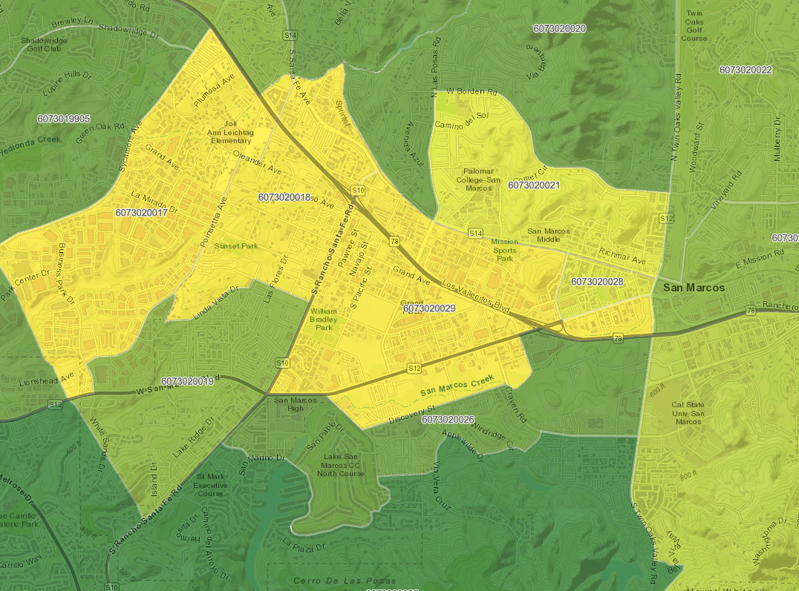
San Marcos CalEnviroScreen 3.0 and 4.0

